Slide 1
Truncation and Selection
Categorical and Limited
Dependent Variables
Paul A. Jargowsky

Slide 2
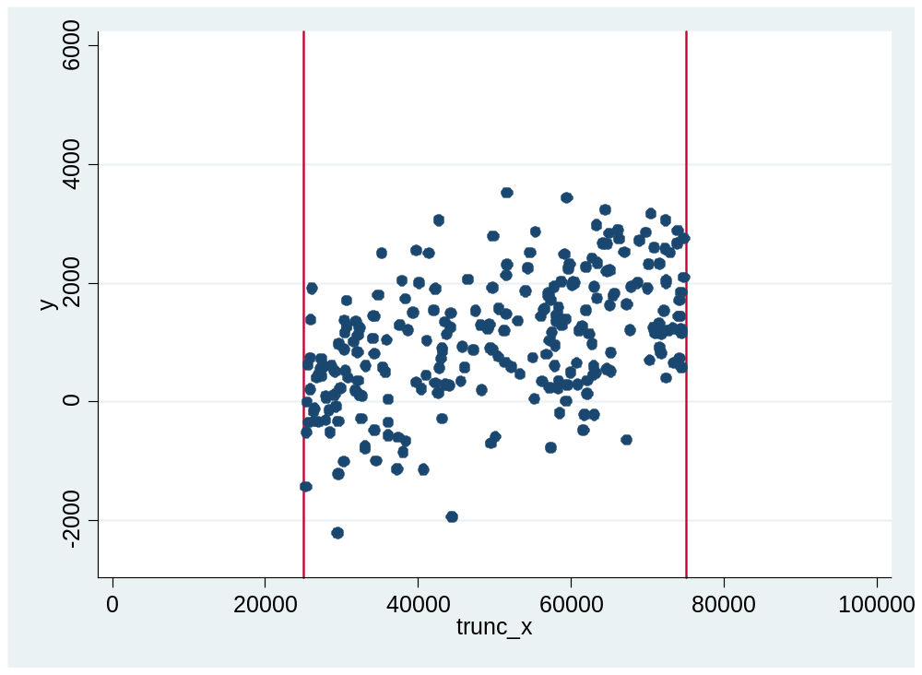
Will Truncation on X Produce a Bias?
. gen trunc_x = max(25000, min(x, 75000))
. sum x trunc_x
Variable | Obs Mean Std. Dev. Min Max
-------------+--------------------------------------------------------
x | 500 52789.5 28320.15 5146.704 99815.15
trunc_x | 500 51511.78 20818.87 25000 75000

Slide 3
Regression on Truncated X
. reg y Trunc_x
Source | SS df MS Number of obs = 248
-------------+------------------------------ F( 1, 246) = 76.41
Model | 66414350.0 1 66414350.0 Prob > F = 0.0000
Residual | 213820520 246 869189.107 R-squared = 0.2370
-------------+------------------------------ Adj R-squared = 0.2339
Total | 280234870 247 1134554.13 Root MSE = 932.30
------------------------------------------------------------------------------
y | Coef. Std. Err. t P>|t| [95% Conf. Interval]
-------------+----------------------------------------------------------------
Trunc_x | .0332953 .003809 8.74 0.000 .0257929 .0407977
_cons | -635.3248 200.2584 -3.17 0.002 -1029.765 -240.8849
Y
There isn’t a bias, because the full distribution of the disturbance term is always observed.
E(u|x)=0
X

Slide 4
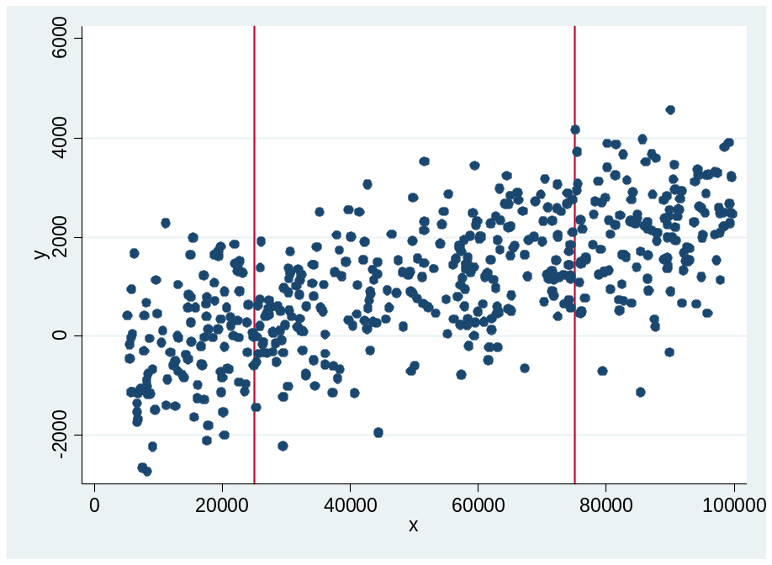
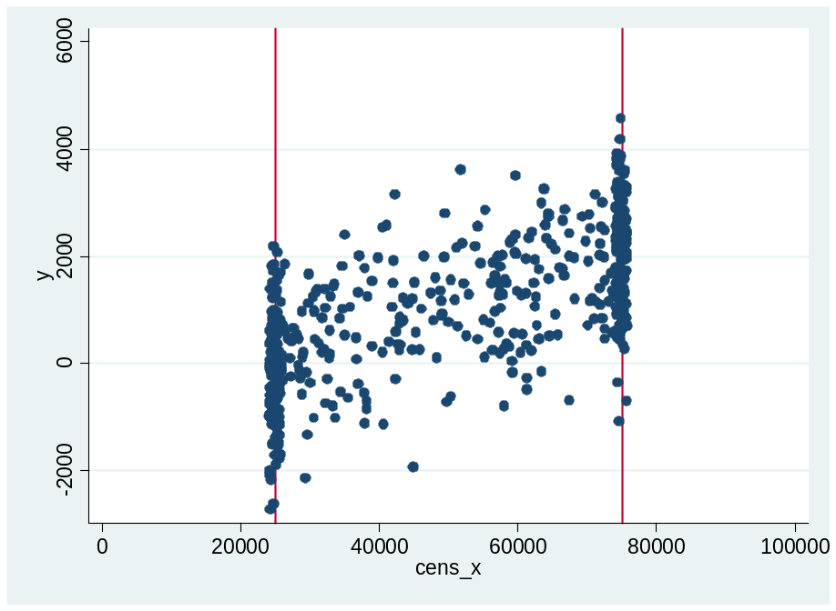
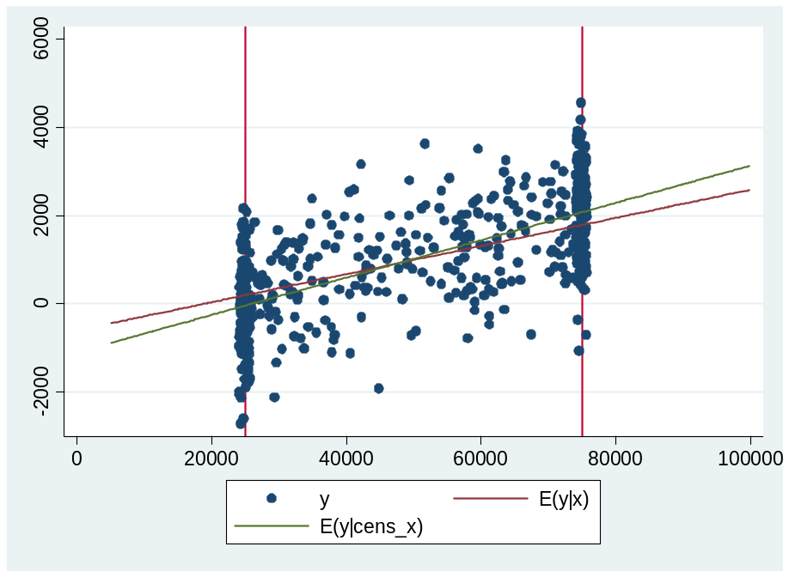
What about Censoring on X?
. reg y Cens_x
Source | SS df MS Number of obs = 500
-------------+------------------------------ F( 1, 498) = 393.62
Model | 389050086 1 389050086 Prob > F = 0.0000
Residual | 492223226 498 988400.052 R-squared = 0.4415
-------------+------------------------------ Adj R-squared = 0.4403
Total | 881273312 499 1766078.78 Root MSE = 994.18
------------------------------------------------------------------------------
y | Coef. Std. Err. t P>|t| [95% Conf. Interval]
-------------+----------------------------------------------------------------
Cens_x | .0424126 .0021378 19.84 0.000 .0382125 .0466128
_cons | -1105.138 118.7568 -9.31 0.000 -1338.464 -871.812

Slide 5
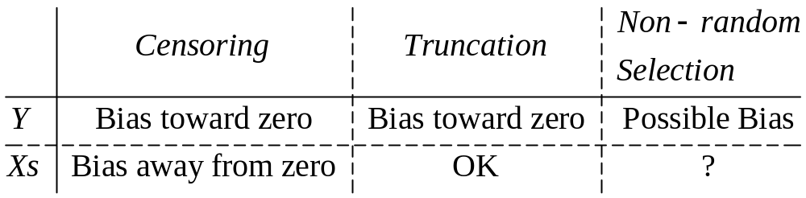
Summary
Truncation on the dependent variable causes bias because the mean value of the disturbance term is no longer zero.
The bias (non-zero mean error) is correlated with the other independent variables, causing LOVB.
Conclusion: NEVER select a sample by selecting on the dependent variable (Y). If you have to select, select a sample based on the Xs.

Slide 6
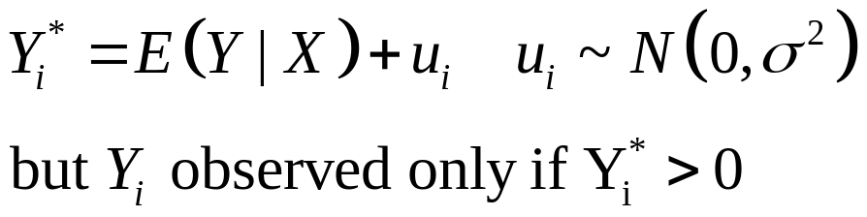
Revisit Truncation on Y as a Left Out Variable Bias (LOVB) Problem
The part of the disturbance term that is actually observed varies with X. For example, in A, only large positive disturbances are seen. The expected value of Y includes the mean value of the observed disturbance term.
0
X
C
B
A

Slide 7
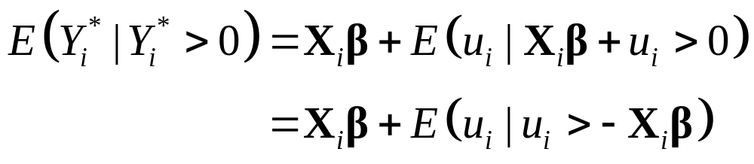



Expected Value of the Bias
The expected value of the disturbance term varies depending on the value of X as shown:
A
B
C
The means of these truncated distributions differ, but how can we calculate the expected value of each?

Slide 8
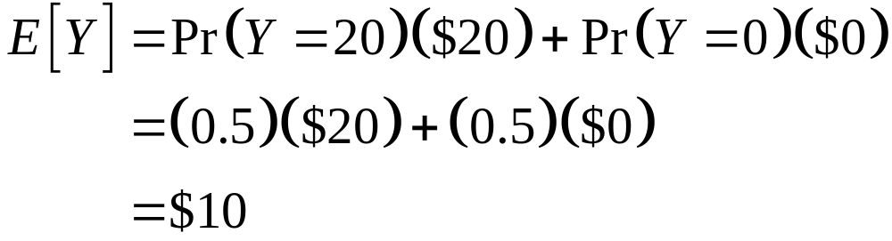
What is the Mean (Expected Value) of a Probability Distribution?
What is it worth?
  50 % chance of $20, 50% chance of $0
  Will you pay me $1?
  Will you pay me $19?
  What is the most you would pay?
Ho do you decide?
  Expected Value
  Risk Tolerance

Slide 9
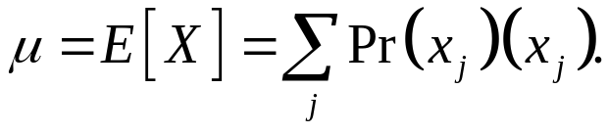

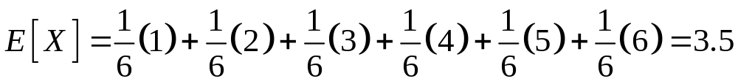
Mean Value of a Discrete Probability Distribution
In general if X is a discrete random variable with outcomes x₁,x₂,…,x_{j}, then the expected value (or mean) of the variable is
(Sum of probabilities*outcomes.)
Rolling one die:
Rolling two dice:

Slide 10
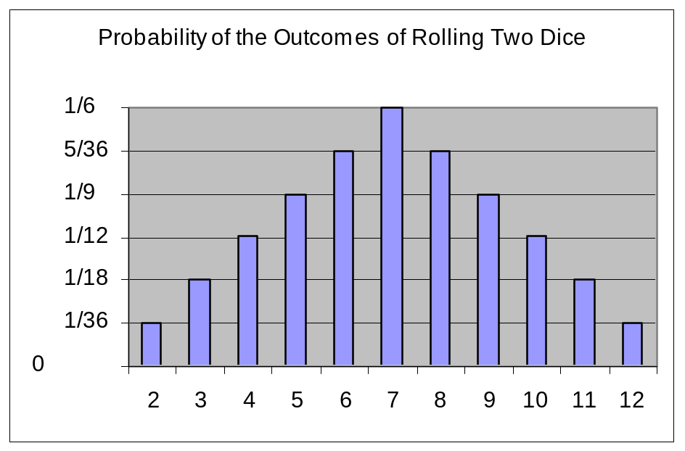
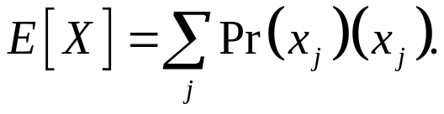
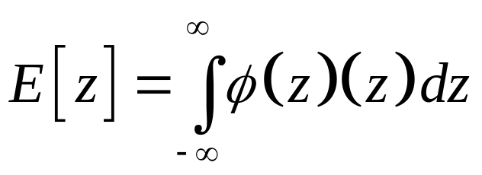
From discrete to continuous
.4
density
Still just the sum of the “probabilities” (actually densities) times the outcomes.
0
0

Slide 11
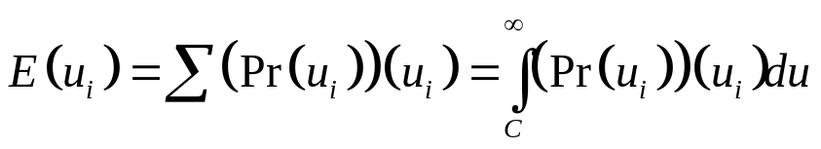
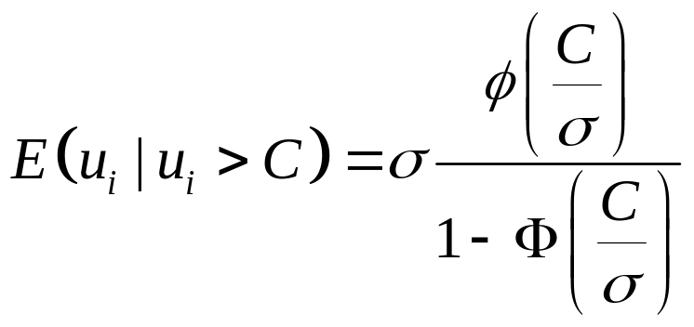

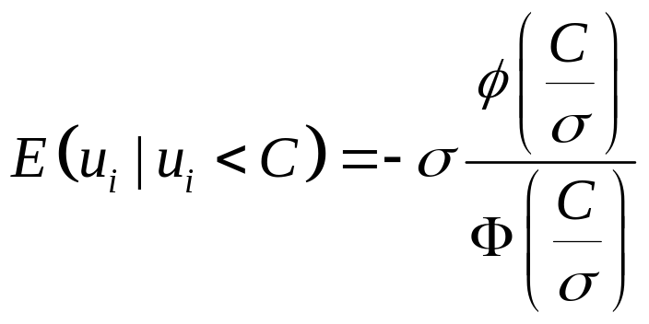
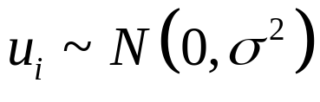
What is the mean of a truncated normal distribution??
If truncated below C:
If truncated above C:
C
0

Slide 12
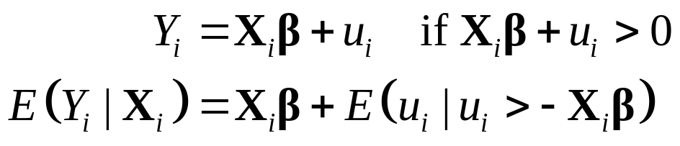
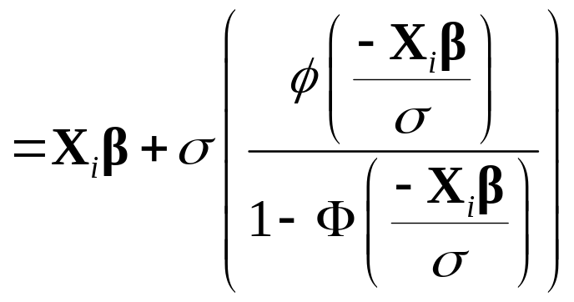
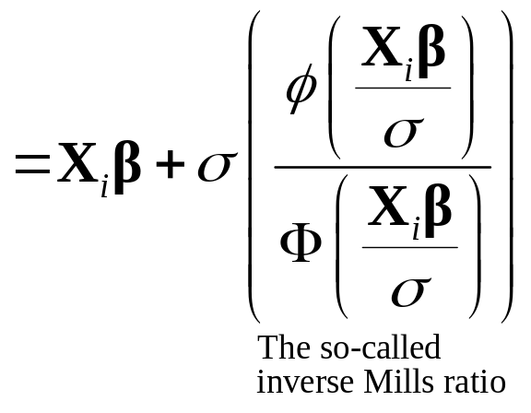
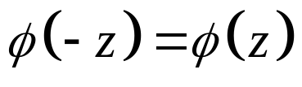
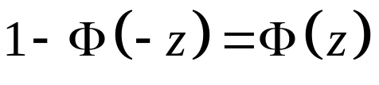
Fixing the LOVB due to Truncation
The mean of a normal distribution truncated at 0.
Symmetry:
Symmetry:

Slide 13

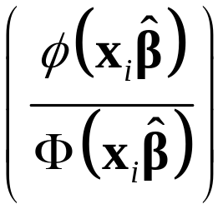
The Heckman Two Step (for truncation)
Assume you have truncation (missing values on Y below a fixed cut off ). But you do have measures on the Xs for these observations. E.g. we know education, etc., for people with no observed wage because their market wage is below the minimum and they don’t get hired but they are in the data.
The first stage:
  Estimate a probit on Z (can be same or different than X). This gives .
  Calculate Inverse Mills Ratio (IMR) = .
The second stage:
  Estimate OLS on the X’s, but adding IMR as a variable.
  Coefficient on IMR is estimate of σ.
  Coefficient estimates should be similar to Tobit.
Example using tobit.dta

Slide 14
Selection Bias
Selection problems endemic in social science
  Attrition in experiments
  People move, die, etc.
  PSID: lost 40 percent of sample since 1968
Example: estimating neighborhood effects
  Outcomes for kids worse in poor neighborhoods even after controlling for family income
  Unobserved characteristics of parents may differ, e.g. degree of concern for child’s environment
  “Concern” correlated with neighborhood, affects outcome → therefore, LOVB
Similar (but not the same as) Truncation

Slide 15
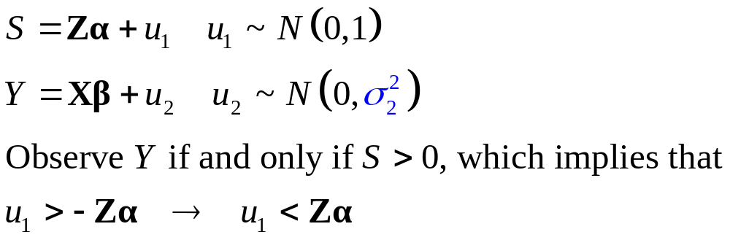
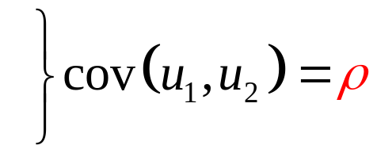
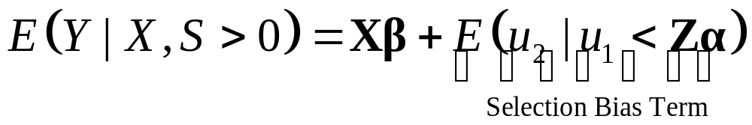
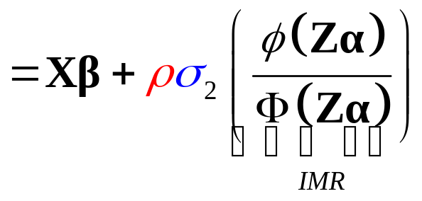
The Heckman Correction for Selection Bias
Setup:
Normally, this term would be zero [E(u)=0], except for the effect of selection.
Note: no bias unless there is correlation in the disturbance terms of the two equations. Thus, if you can control for all “relevant” factors causing the selection, there is no selection bias.

Slide 16
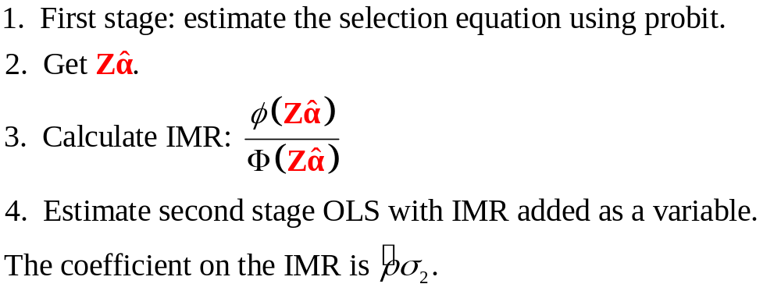
The Heckman Correction (two step method)
Note 1: the Zs in the first stage do not have to be the same as the Xs in the second stage. In fact, it is best if there are at least some variables that are different. These identify the IMR. Otherwise, the IMR is identified only by the non-linearity of the functional form, putting undue weight on the normality assumption.
Note 2: the ML version estimates the two equations jointly. This is preferred and produces more efficient estimates.

Slide 17
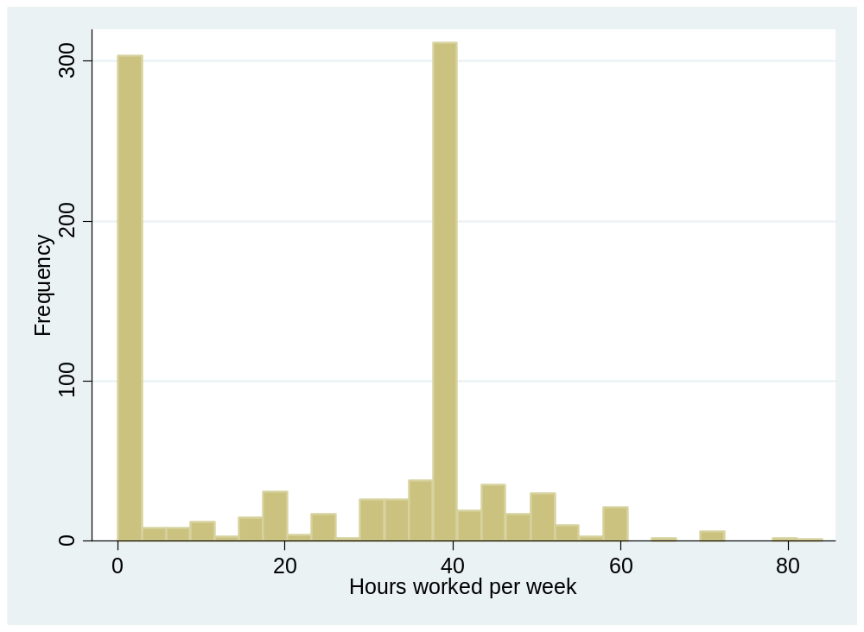
Example: Hours of Work
There is censoring at 0 hours.
(Another oddity of the data is that people who work at all, tend to work 40 hours, due to “institutional constraints.”)

Slide 18
Hours: Viewed as Selection
The First Stage Equation
. gen worked = (hours>0)
. probit worked age educ male black hisp
Probit estimates Number of obs = 950
LR chi2(5) = 65.93
Prob > chi2 = 0.0000
Log likelihood = -561.80507 Pseudo R2 = 0.0554
------------------------------------------------------------------------------
worked | Coef. Std. Err. z P>|z| [95% Conf. Interval]
-------------+----------------------------------------------------------------
age | .0496219 .01549 3.20 0.001 .0192621 .0799817
educ | .0595944 .0186867 3.19 0.001 .0229691 .0962197
male | .4286105 .0872809 4.91 0.000 .2575431 .5996779
black | -.5050203 .1409938 -3.58 0.000 -.7813631 -.2286774
hisp | -.1849729 .1606541 -1.15 0.250 -.4998491 .1299034
_cons | -1.69046 .4529288 -3.73 0.000 -2.578184 -.8027359
This equation indicates that age and gender affect whether a person works or not, with males and older persons more likely to work.

Slide 19
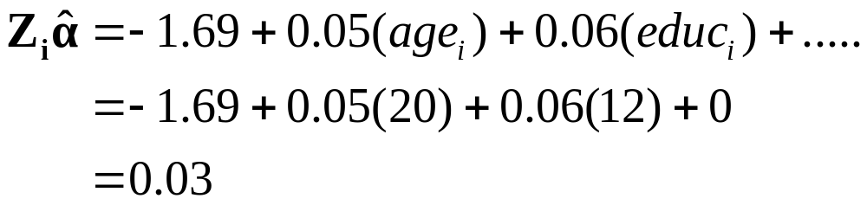
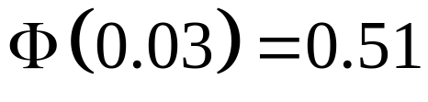
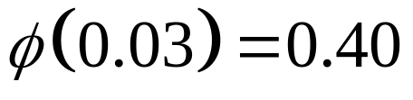
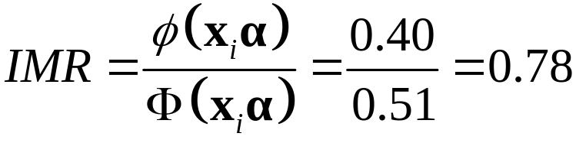
Constructing the inverse mills ratio

Slide 20
The Second Stage
Age and gender are no longer statistically significant.
. predict xb, xb
. gen imr = normalden(xb)/normal(xb)
. replace hours =. if hours==0
* With Inverse Mills Ratio
. reg hours age educ male black hisp imr
Source | SS df MS Number of obs = 647
-------------+------------------------------ F( 6, 640) = 8.28
Model | 6477.91092 6 1079.65182 Prob > F = 0.0000
Residual | 83418.46 640 130.341344 R-squared = 0.0721
-------------+------------------------------ Adj R-squared = 0.0634
Total | 89896.3709 646 139.158469 Root MSE = 11.417
------------------------------------------------------------------------------
hours | Coef. Std. Err. t P>|t| [95% Conf. Interval]
-------------+----------------------------------------------------------------
age | 1.038383 .6753362 1.54 0.125 -.2877595 2.364525
educ | .0908574 .7978692 0.11 0.909 -1.4759 1.657615
male | 4.835125 5.750201 0.84 0.401 -6.456415 16.12666
black | -4.471784 7.519623 -0.59 0.552 -19.2379 10.29433
hisp | -2.001323 3.334272 -0.60 0.549 -8.548758 4.546113
imr | 6.413876 26.74491 0.24 0.811 -46.1045 58.93225
_cons | 5.45911 42.86825 0.13 0.899 -78.72031 89.63853

Slide 21
. heckman hours age educ male black hisp, select(age educ male black hisp) twostep
------------------------------------------------------------------------------
| Coef. Std. Err. z P>|z| [95% Conf. Interval]
-------------+----------------------------------------------------------------
hours |
age | 1.038384 .673713 1.54 0.123 -.2820697 2.358837
educ | .0908581 .7969899 0.11 0.909 -1.471213 1.65293
male | 4.83513 5.725938 0.84 0.398 -6.387503 16.05776
black | -4.471791 7.495242 -0.60 0.551 -19.16219 10.21861
hisp | -2.001325 3.355865 -0.60 0.551 -8.578699 4.576049
_cons | 5.45907 42.67145 0.13 0.898 -78.17544 89.09358
-------------+----------------------------------------------------------------
select |
age | .0496219 .01549 3.20 0.001 .0192621 .0799817
educ | .0595944 .0186867 3.19 0.001 .0229691 .0962197
male | .4286105 .0872809 4.91 0.000 .2575431 .5996779
black | -.5050203 .1409938 -3.58 0.000 -.7813631 -.2286774
hisp | -.1849729 .1606541 -1.15 0.250 -.4998491 .1299034
_cons | -1.69046 .4529288 -3.73 0.000 -2.578184 -.8027359
-------------+----------------------------------------------------------------
mills |
lambda | 6.413901 26.57183 0.24 0.809 -45.66592 58.49373
-------------+----------------------------------------------------------------
rho | 0.52504
sigma | 12.215956
lambda | 6.4139006 26.57183
FIML is better, but twostep confirms our “manual” Heckman results exactly.

Slide 22
Heckman FIML (no twostep option)
------------------------------------------------------------------------------
| Coef. Std. Err. z P>|z| [95% Conf. Interval]
-------------+----------------------------------------------------------------
hours |
age | .9236034 .2068904 4.46 0.000 .5181057 1.329101
educ | -.0449971 .2487941 -0.18 0.856 -.5326245 .4426303
black | -3.188473 2.204398 -1.45 0.148 -7.509013 1.132067
hisp | -1.514983 1.923181 -0.79 0.431 -5.284349 2.254384
male | 3.836844 1.387073 2.77 0.006 1.118231 6.555456
_cons | 12.94534 9.220131 1.40 0.160 -5.125784 31.01646
-------------+----------------------------------------------------------------
select |
age | .0494811 .015468 3.20 0.001 .0191644 .0797979
educ | .0602065 .0188663 3.19 0.001 .0232292 .0971838
black | -.5023835 .1412058 -3.56 0.000 -.7791418 -.2256252
hisp | -.1846652 .1606639 -1.15 0.250 -.4995607 .1302303
male | .4293998 .0873135 4.92 0.000 .2582684 .6005312
_cons | -1.696099 .4531538 -3.74 0.000 -2.584264 -.8079339
-------------+----------------------------------------------------------------
/athrho | .151408 .4393153 0.34 0.730 -.7096342 1.01245
/lnsigma | 2.435282 .0427187 57.01 0.000 2.351555 2.519009
-------------+----------------------------------------------------------------
rho | .1502615 .4293962 -.6104474 .7667735
sigma | 11.41904 .4878061 10.50189 12.41629
lambda | 1.715842 4.959177 -8.003966 11.43565
------------------------------------------------------------------------------
LR test of indep. eqns. (rho = 0): chi2(1) = 0.05 Prob > chi2 = 0.8239
------------------------------------------------------------------------------

Slide 23
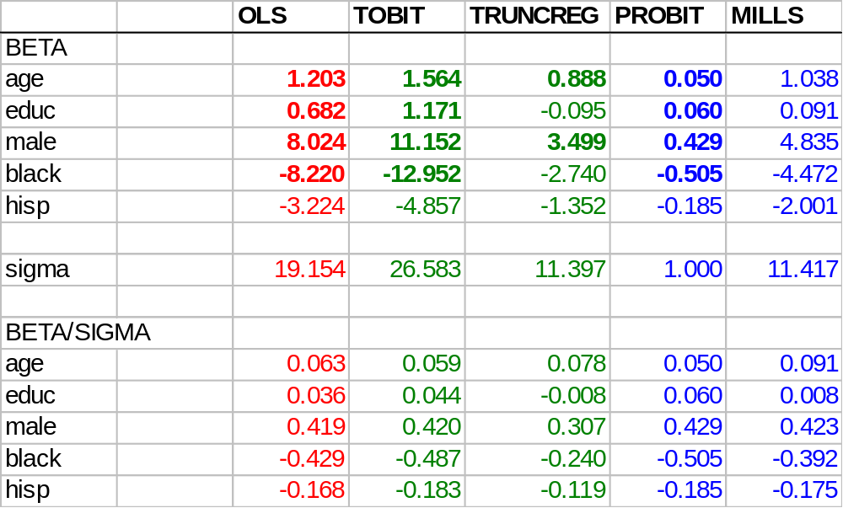
Summary of Hours Models
Note: probit assumes σ=1. Red = biased. Green assumes that whether you work and how many hours you work are determined by the same underlying model. Heckman results allow those models to differ.

Slide 24
Summary and Advice
Often many ways to estimate the same equation
Carefully examine your assumptions about how the data were generated, including selection processes
Test the robustness of findings against alternative specifications. If results differ, try to understand which specification is more consistent with theory and evidence
Be prepared to defend your model

Slide 25
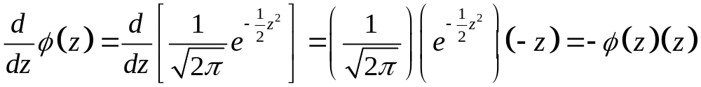
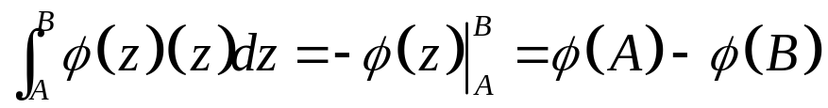
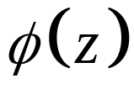
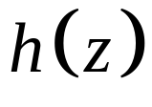
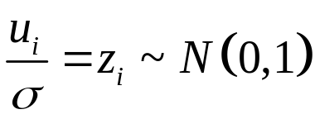
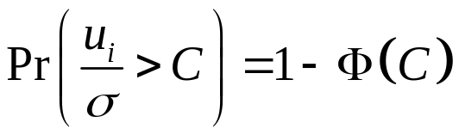
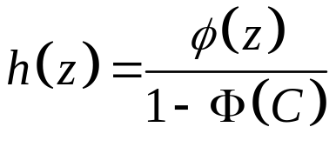
Appendix: Proof of Mean of Truncated Distribution (Optional! Math nerds only!)
First, a useful result. The derivative of the normal density:
Therefore:
Now the problem:
.5
.4
Lower truncation at C
.3
.2
.1
0
-3
-2
-1
0
1
2
3
C
z

Slide 26
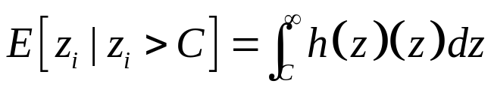
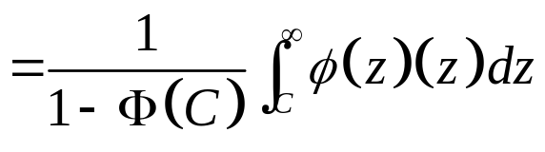
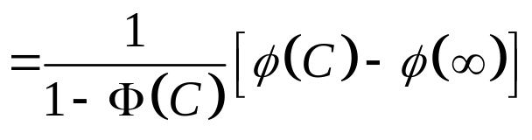
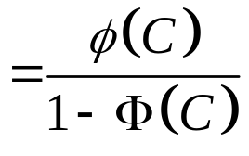
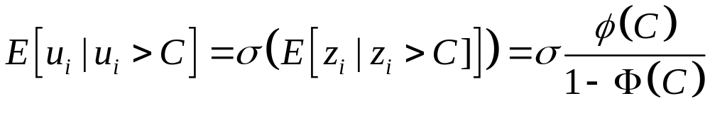
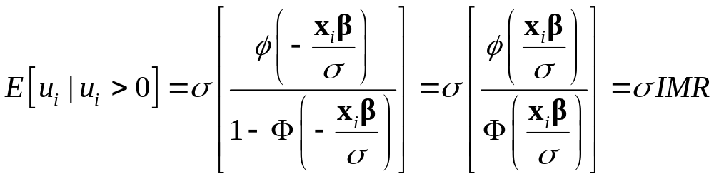
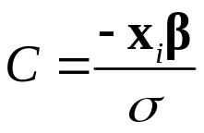
The expected value of a truncated standard normal
Scaled by σ
For truncation at 0:

